Slide 1




Science at the Star: Science Journalism Lessons for Scientists
Patrick O’Connor
Mentor: Tom Beal/Sarah Gassen
Arizona Daily Star
25th Annual Arizona Space Grant Consortium Symposium
University of Arizona April 16, 2016

Slide 2
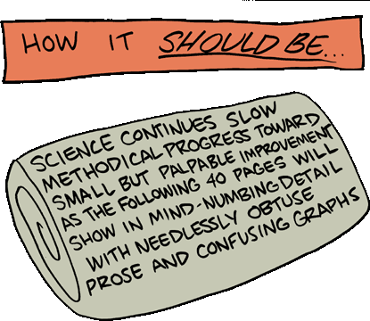
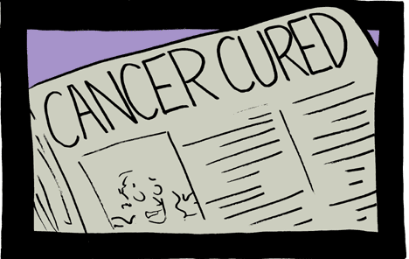
What I Want:
What Scientists Want:
Saturday Morning Breakfast Cereal

Slide 3
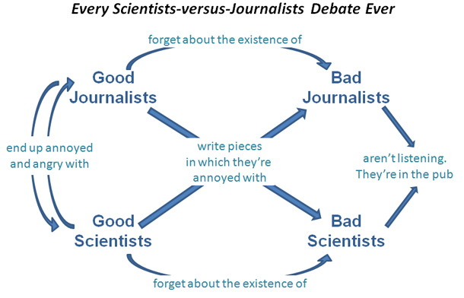
The Problem:
Ed Yong/Discover Magazine

Slide 4
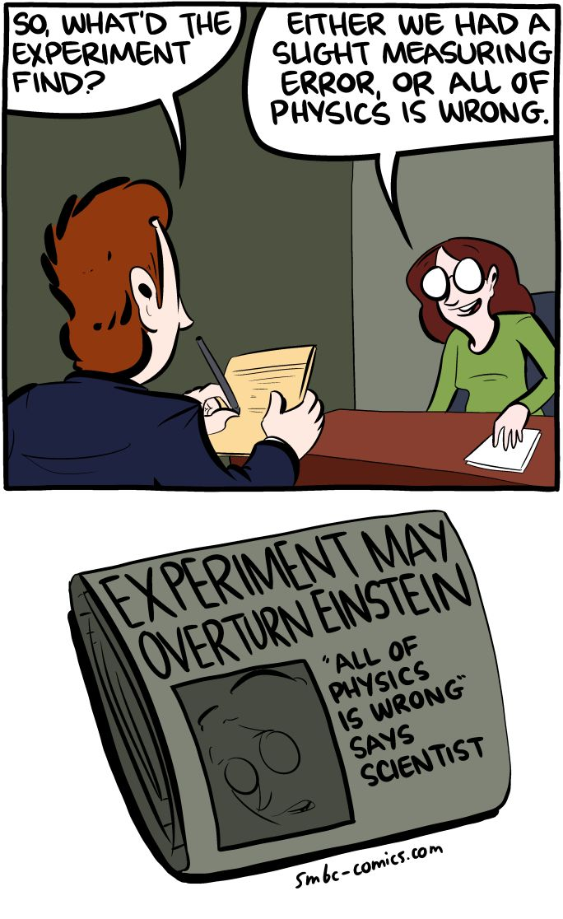
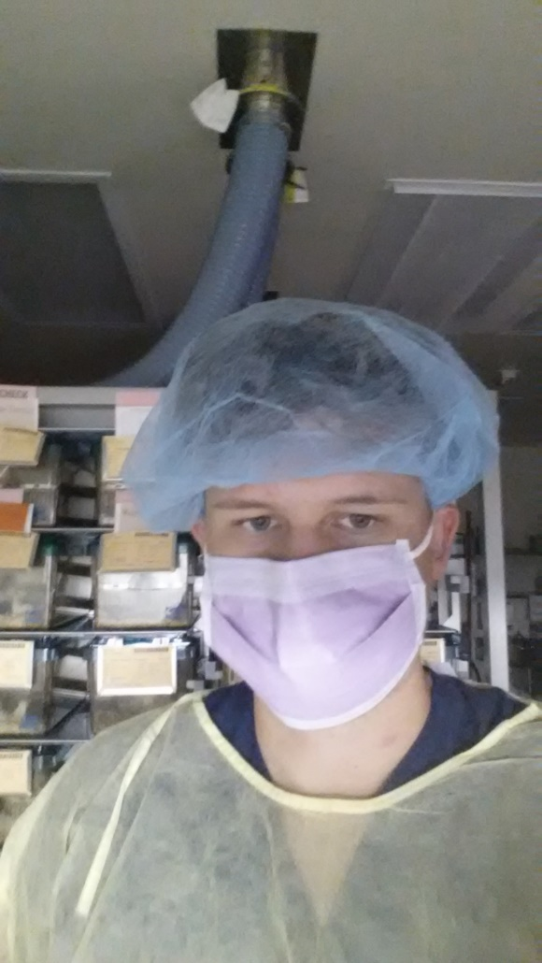
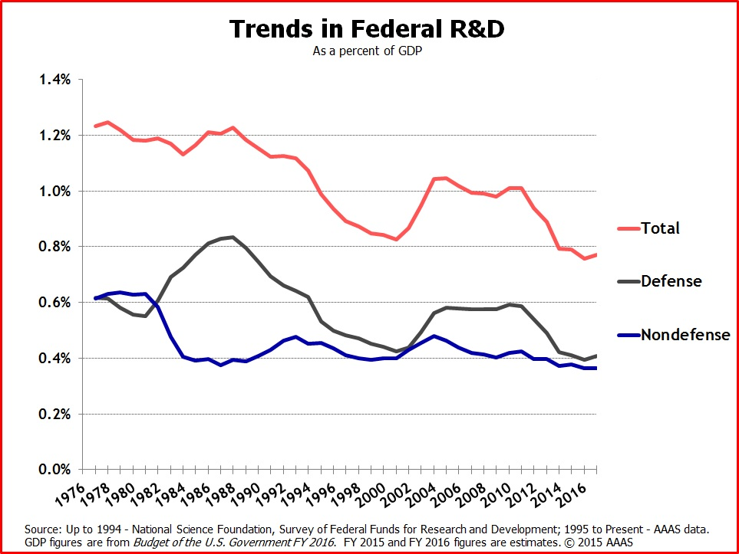
Why Should You Risk It?
Saturday Morning Breakfast Cereal

Slide 5
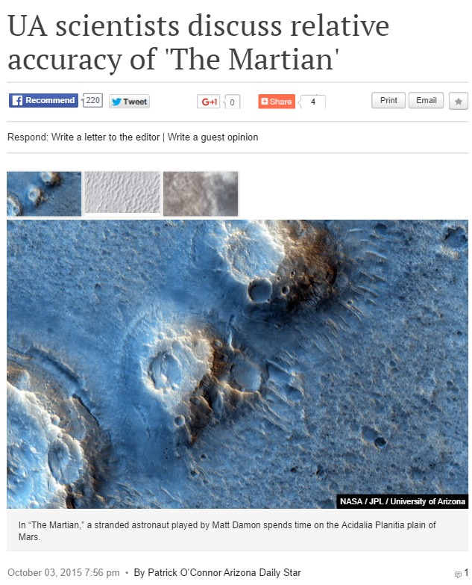
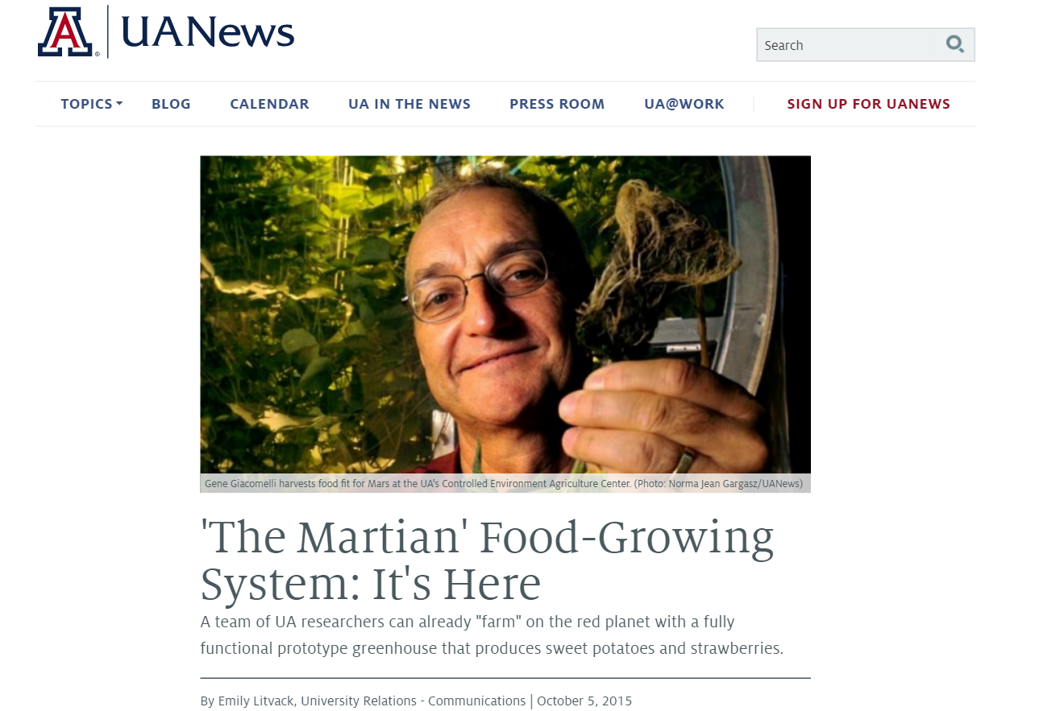
Look Towards Pop Culture:
Look for upcoming books, movies, television shows, video games, etc. that may relate to your research.
Consider drafting a press release with your institution's PIO/Communication Office

Slide 6
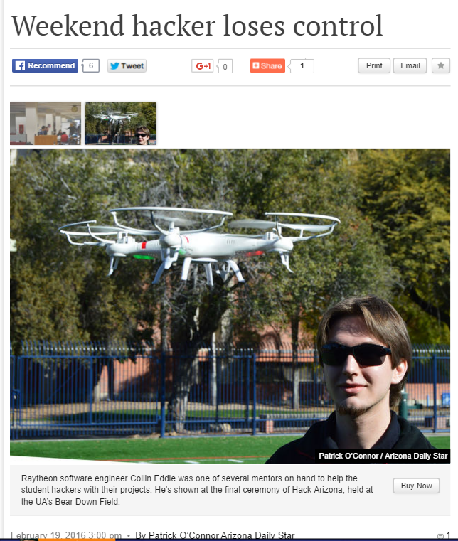
Think about your Methods:
Often what is most interesting to you may not be the most interesting part of your research.
Story: Students make projects at a hackathon
  Angle A: Make a list of all the cool projects and interview the teams
  Angle B: Follow one team and document their trials and tribulations through the hackathon
I am in the business of telling stories. The projects were interesting but the people behind the projects fleshed out the narrative.

Slide 7
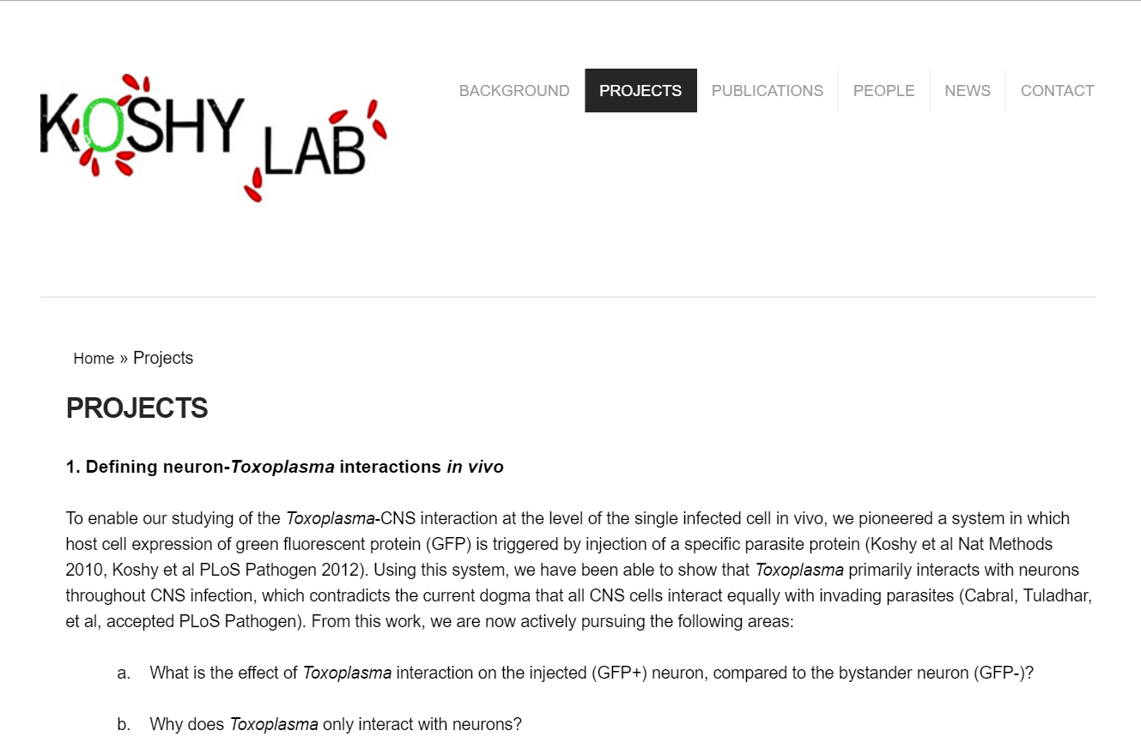
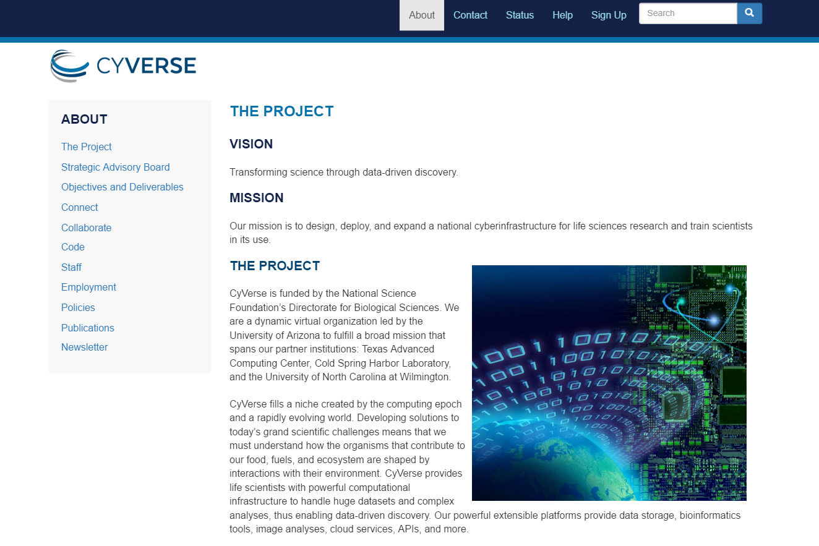
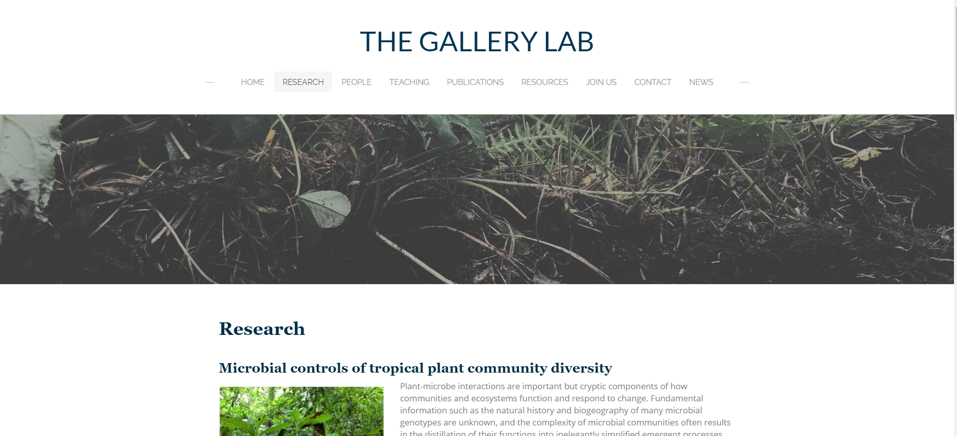
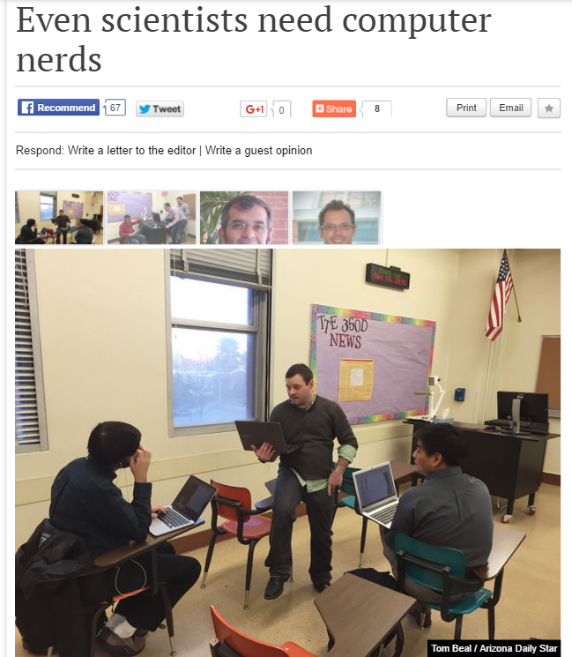
Get Online:
Having an updated website makes your lab very easy to find and to fact check.
Not all journalists have access to research databases 24/7 if at all.
Your faculty page on your department website is not enough.

Slide 8
Parting Thoughts:
Talk to your institution’s PIO or communication department. They are there to help you.
Make updating the Lab Website/Twitter/Facebook a duty at lab meeting.
Use new movies, television shows, video games, and books to springboard discussion about your research.
Remember that the methods section is just as important as the results and conclusions.

Slide 9
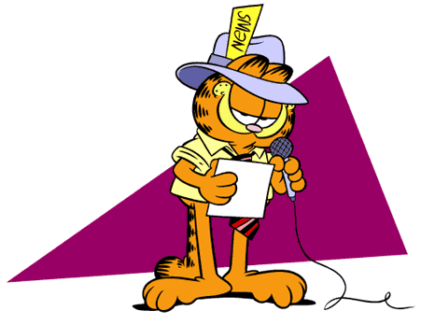
Thank you!

